Slide 1
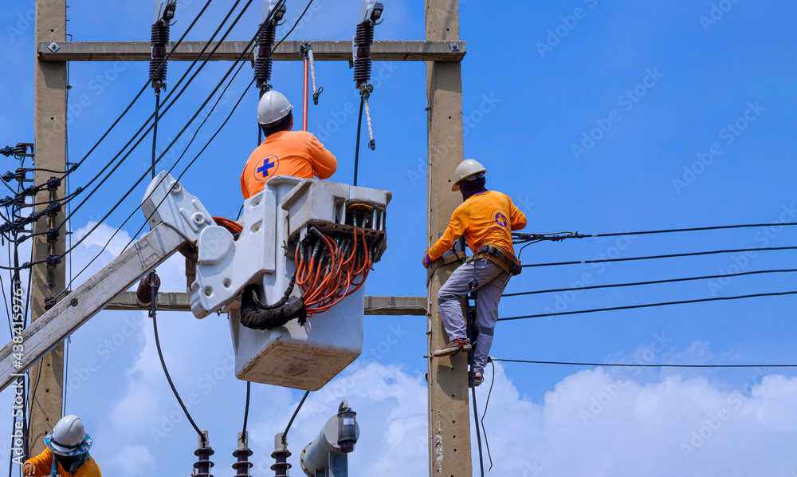
Asset Maintenance – Specifications in Picture
WI 118547 Asset Maintenance
118547 | Asset Maintenance
118547 | Asset Maintenance

Slide 2
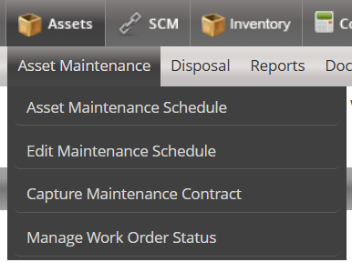
Create the following Menu Items under Asset Maintenance
Planned Maintenance
Reactive Maintenance

Slide 3
Create the following Menu Items under Planned Maintenance
Planned Maintenance
Upload Maintenance Plans
Take On Maintenance Schedules
Approve Maintenance Schedule Take on
Capture Asset Maintenance Schedule
Approve Maintenance Schedule
Edit Maintenance Schedule
Manage Work Order

Slide 4
Create the following Menu Items under Reactive Maintenance
Planned Maintenance
Reactive Maintenance
Capture Maintenance Request
Link Maintenance Request to an Existing Asset
Approve Maintenance Request
Create Work Order
Manage Work Order

